Slide 1
Building Energy Consumption

Slide 2
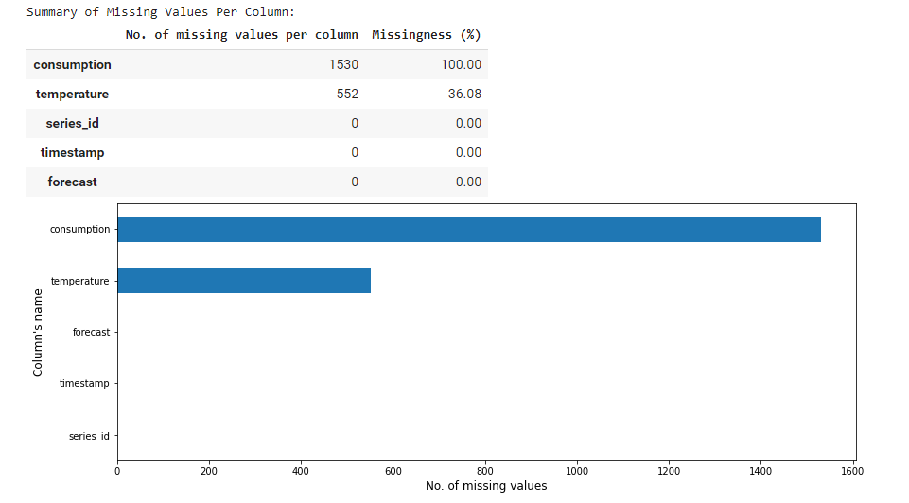
EDA on Predictions

Slide 3
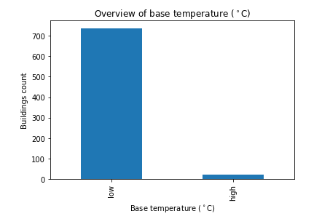
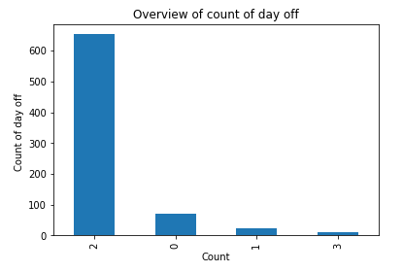
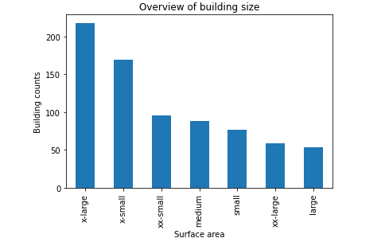
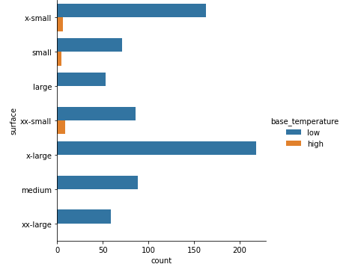
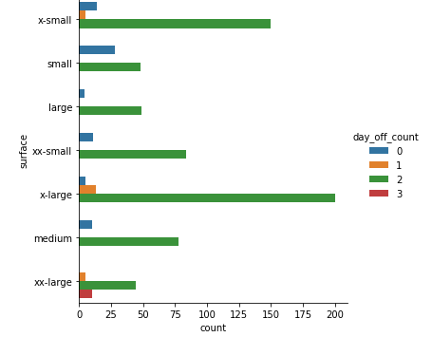
EDA on Metadata

Slide 4
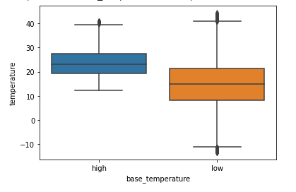
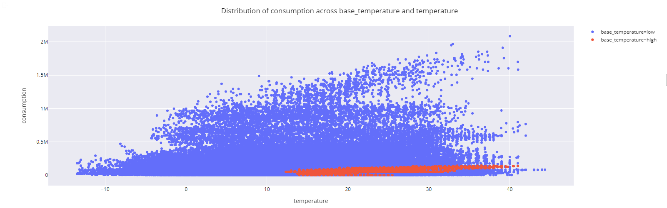
EDA on Train

Slide 5
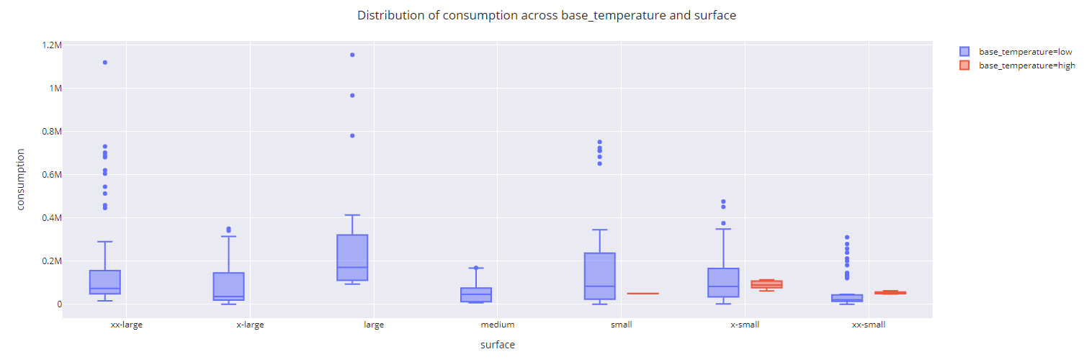
EDA on Train
Inference: There may be different in characteristics of different base temperature buildings.
Smaller buildings are found at high base temperature locations

Slide 6
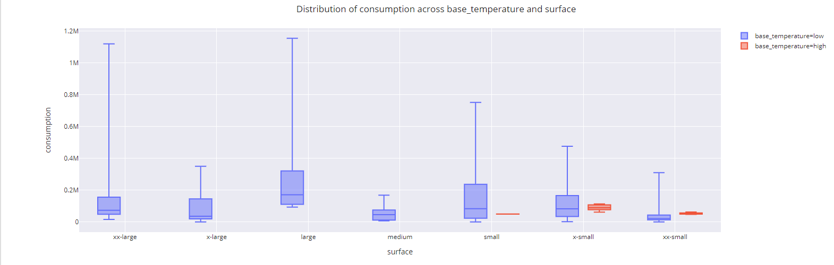
EDA on Train

Slide 7
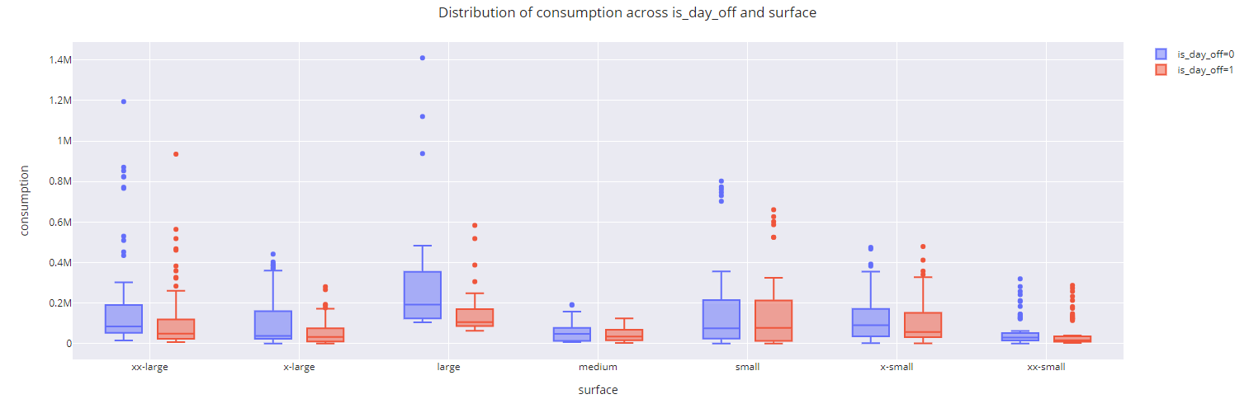
EDA on Train

Slide 8
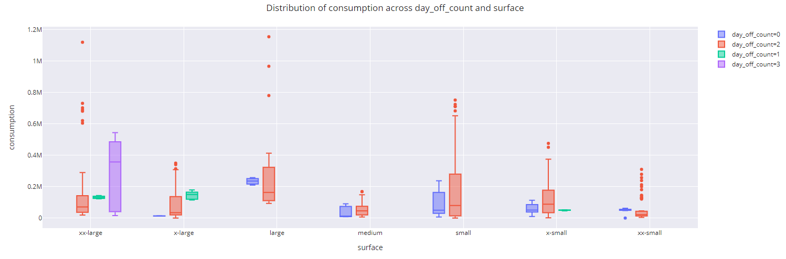
EDA on Train

Slide 9
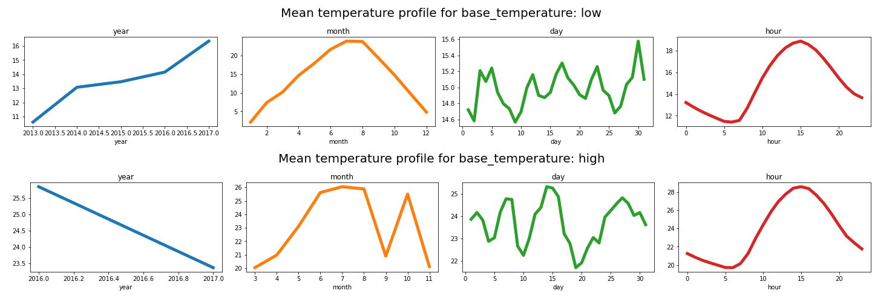
EDA on Train

Slide 10
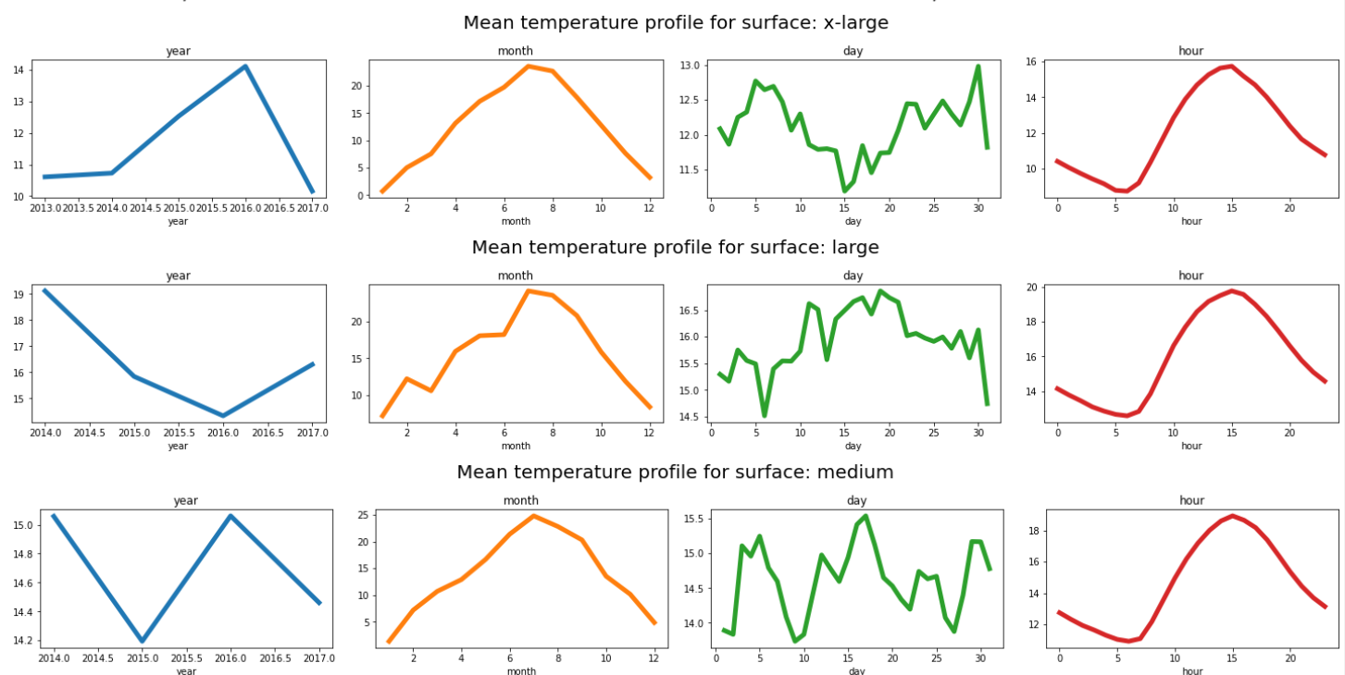
EDA on Train

Slide 11
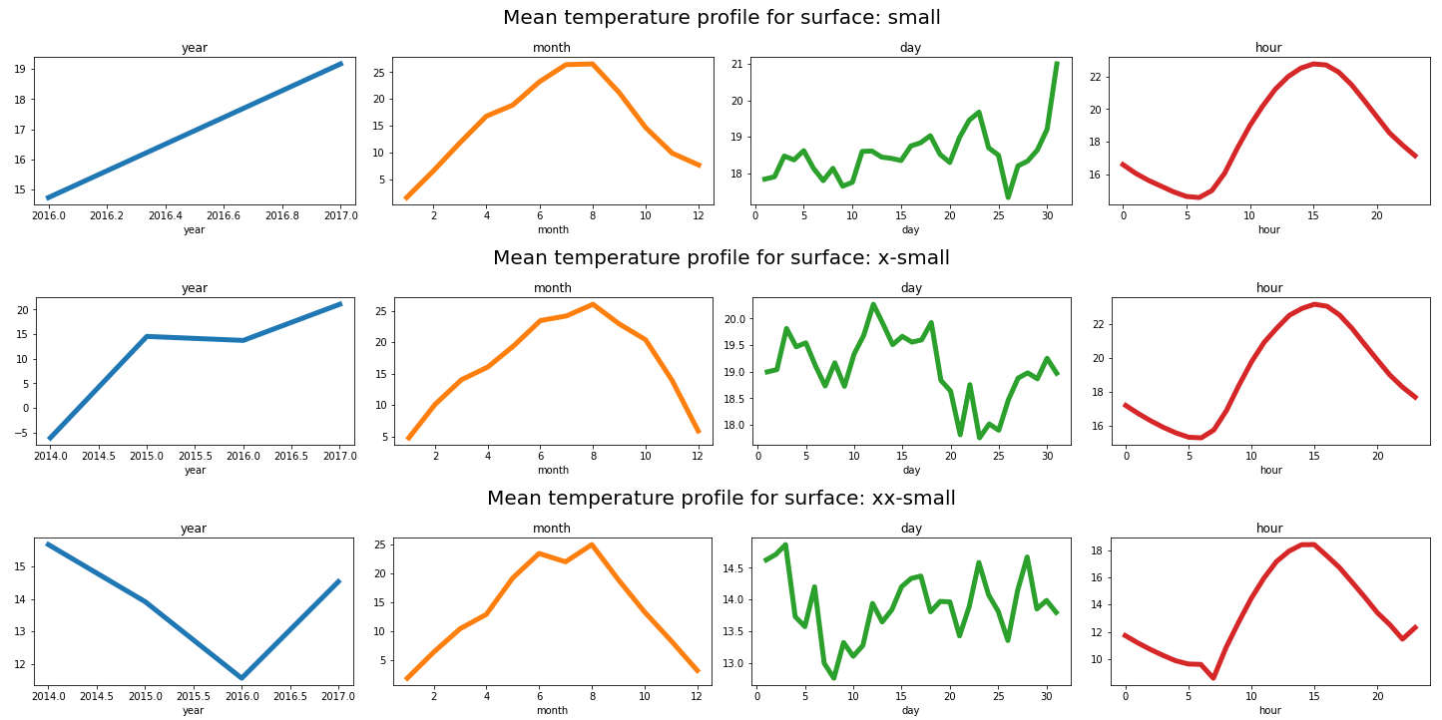
EDA on Train

Slide 12
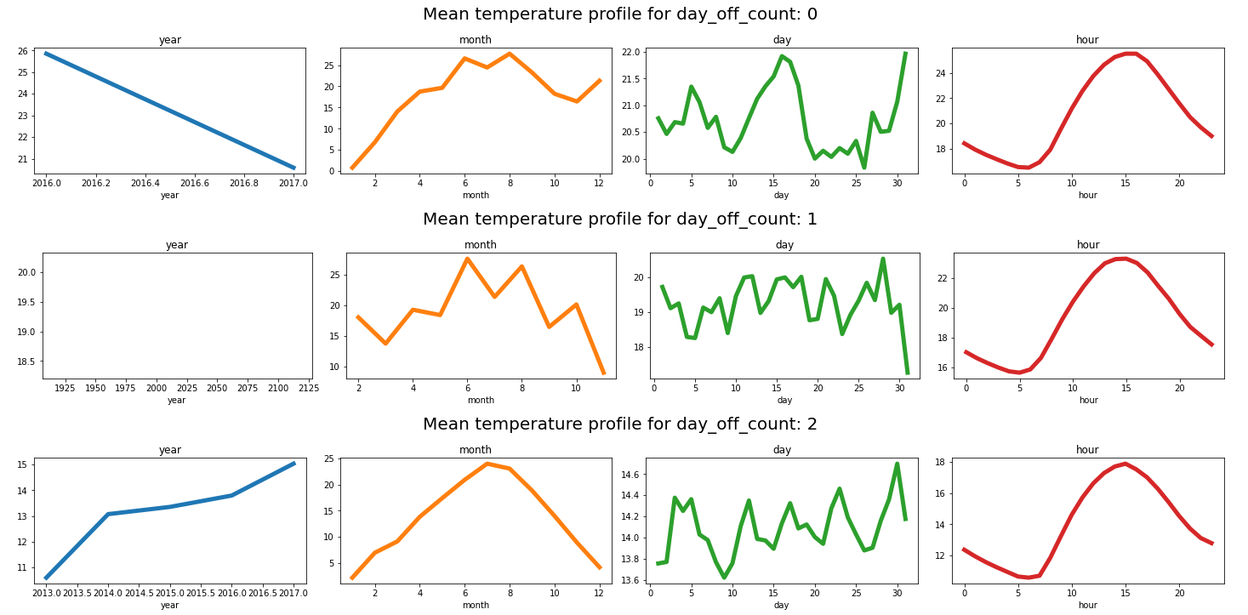
EDA on Train

Slide 13
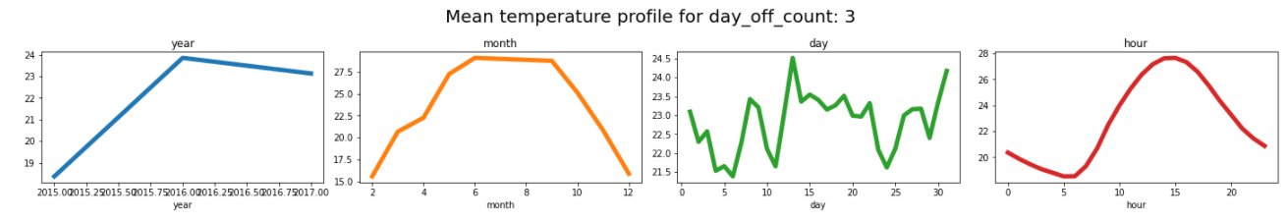
EDA on Train

Slide 14
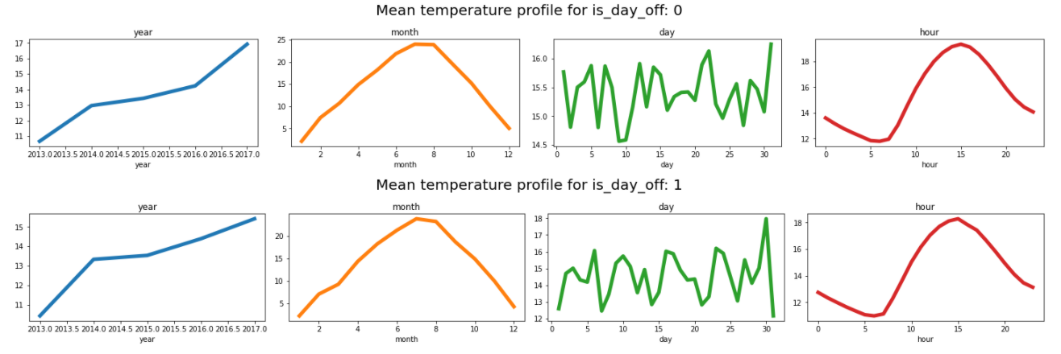
EDA on Train

Slide 15
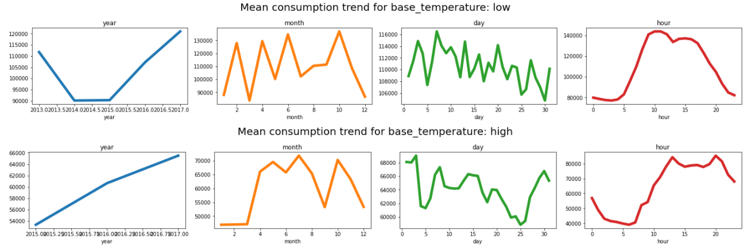
EDA on Train

Slide 16
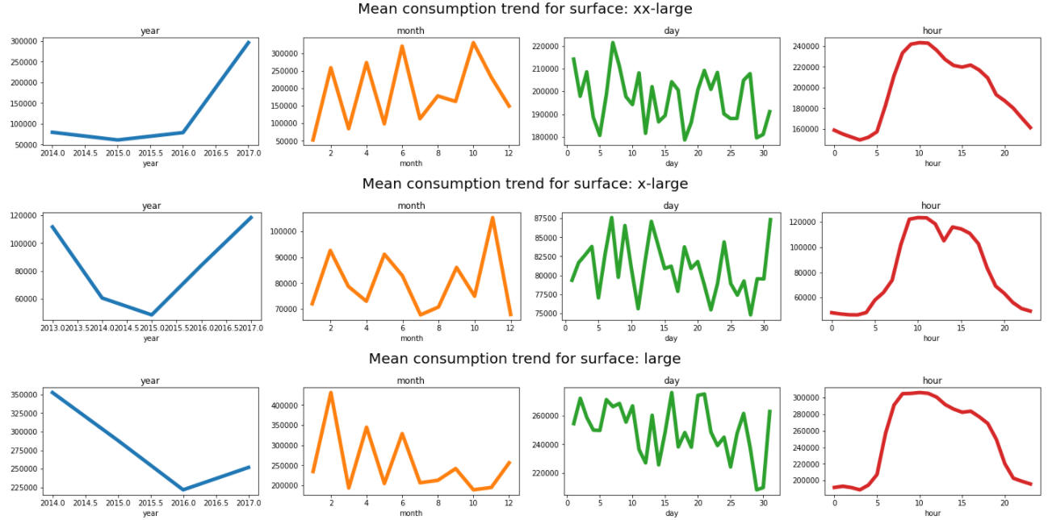
EDA on Train

Slide 17
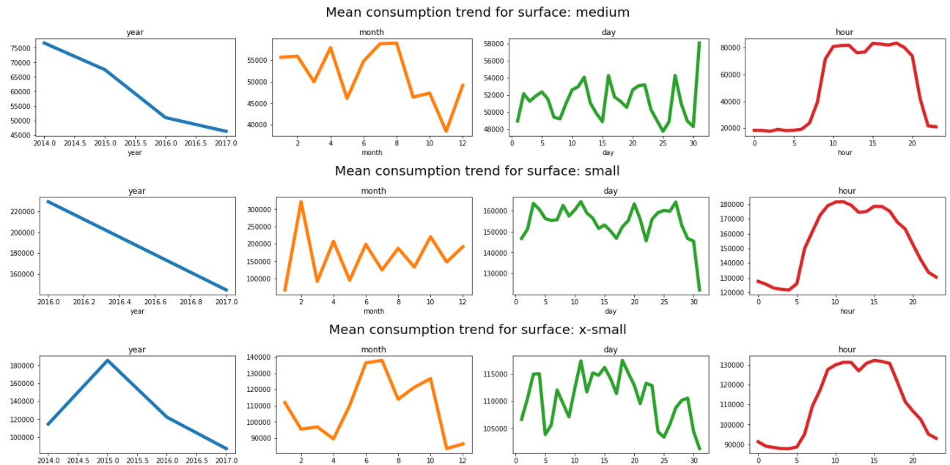
EDA on Train

Slide 18
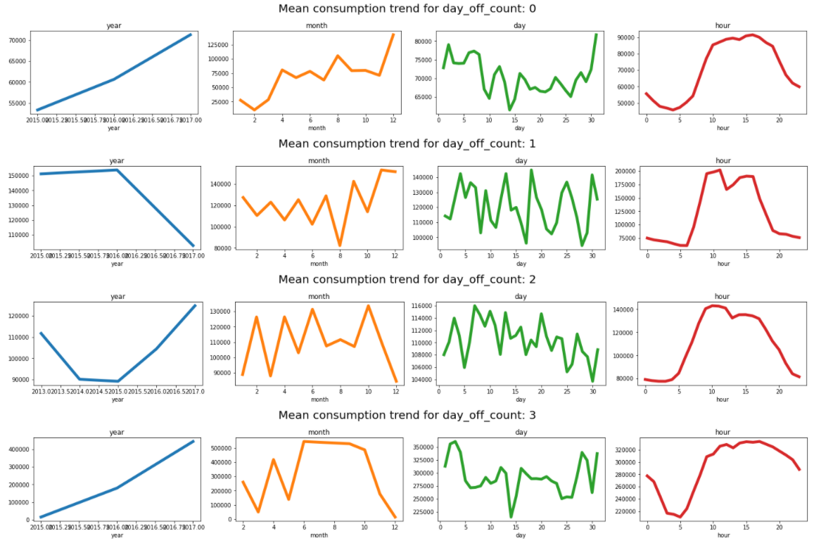
EDA on Train

Slide 19
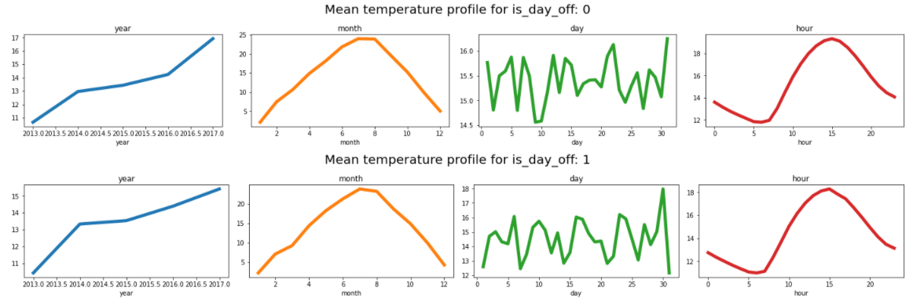
EDA on Train

Slide 20
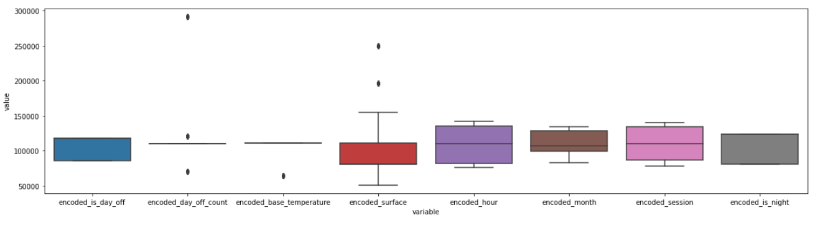
Variance of variables
To decide on the best variables for clustering, highest variance is preferred for identify disparities. From the univariate boxplot, inference:
Encoded surface, encoded is day off, encoded is night, encoded hour
Note: Unable to identify interaction effects between multiple variables - trial and error.

